Slide 1
Introduction to Programming in JAVA
Basics of java and its implementation

Slide 2
JAVA JDK
JDK :- Java Development Kit
A development environment for building applications
Includes tools useful for developing ,testing and monitoring program.
Java JRE(Jave Runtime Environment)
Part of JDK
An environment used to compile and run Java Programs

Slide 3
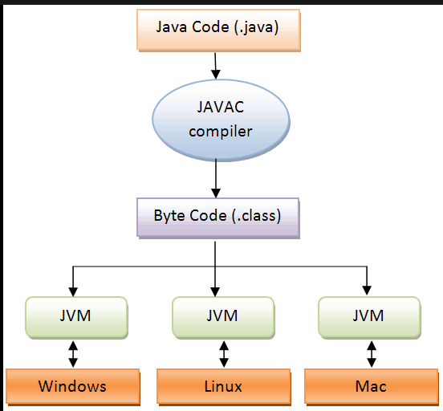
Execution of a JAVA Program

Slide 4
Types of Variables
1. Integres :- int
for storing integer types variables
2. String :- String
Storing multiple characters
3. Characters :- char
Storing single characters
4. Float :- float
Storing decimal values
5. Boolean :- boolean
used to store a value in terms of True or False
6. Final :- final
suggests that the variable cannot be channges after a fixed value

Slide 5


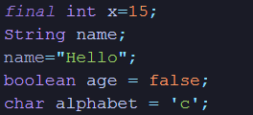
Variables In Java
Variables in C
Variables in Python
Variabls in Java

Slide 6
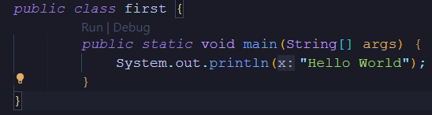
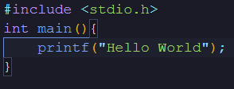
Displaying Output on The terminal
Java
Python
C

Slide 7
Conditional Statements
Conditional statements are executable block of code with certain conditions.
Syntex
if(condition)
{
executable code
}
else
{
executable code
}

Slide 8
Multiple conditional statements
A lader of if else statements with else if
if(condition)
{
code
}
else if(condition)
{
code
}
else
{
code
}

Slide 9
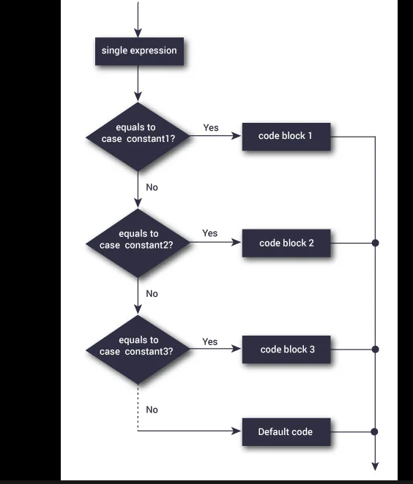
Switch Case

Slide 10
Switch- case Conditional statement
Switch case is used as a replacement for if-else lader as it is faster than the lader
Syntex:-
switch(variable){
case (condition):
code
break;
default:
code
break;
}

Slide 11
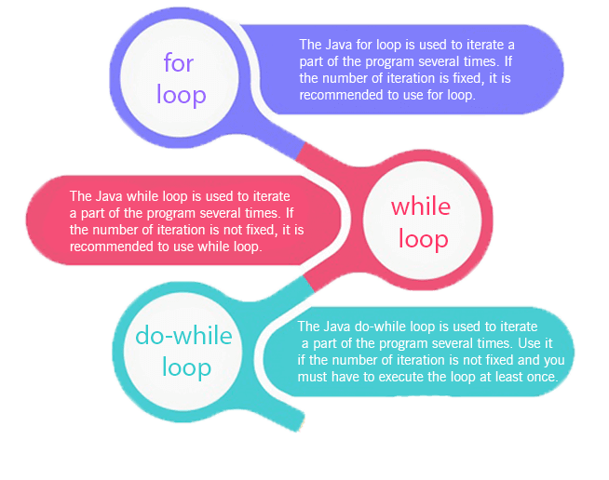
Loops in Java
Loops are used for repeting a code for a perticular number of times

Slide 12
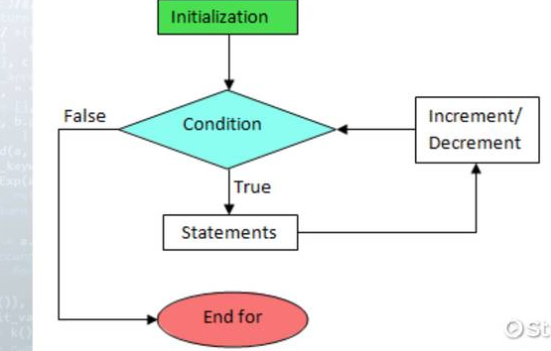
For Loops
Syntex
for(start;end,increment){
code
}

Slide 13
While loop
Syntex:-
start
while(condition){
code
increment
}

Slide 14
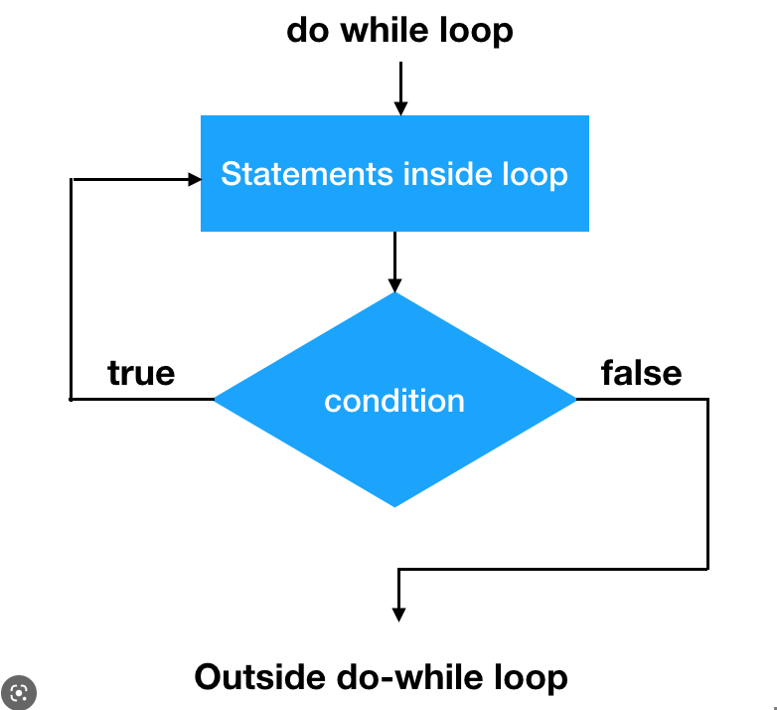
Do-While Loop
Syntex:-
start
do{
code
increment
}while(condition);

Slide 15
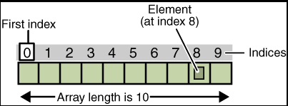
ARRAYS
Arrays are contineou memory allocation for storing same type of data
Elements of an array:
Index of an array
length of an array
elements in an array

Slide 16


Functions
Static Function
These are a group of code that can be used again and again instead of typing it.
Types of functions:-
1.Static function:- these functions can be called directly .
2.Non static funuctions:- these functions need the instances of the class the they belong to.
Static Function Call
Non Static Function
Non Stat Function Call

Slide 17

Strings
These represents the sequence of charcters.
These are also a data type

Slide 18
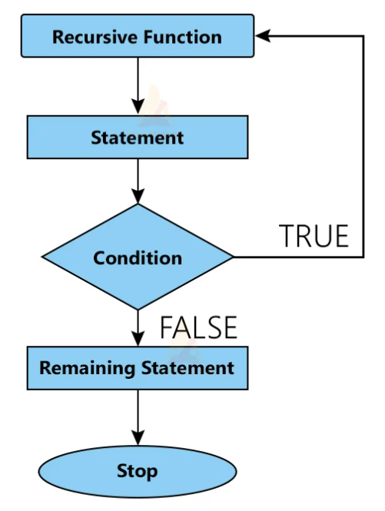
Recursion
It is the process by which a functions is called againg and agin by itself until a condition is matched.

Slide 19
Ploblem Solving
Q1: Make a calculator using switch case and functions.

Slide 20
Q2.Take user input for an array and display it usings loops.

Slide 21

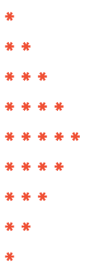
Q3. Print the following pattern
1. 2.

